Slide 1



DOMAIN 1: VENTURE CAPITAL StartupSavvy
Presented by: Byte Council

Slide 2





MEET OUR TEAM
AZFAR IRFAN DANISH BIN AZRUL FAHMEE - Gold medal award 2019 INNOCOM - Student exchange alumni in USA
NOR IZNA BINTI MOHD ISA - Gold Medallist AICD 2021 - Participant in VHack 2022 and 2023
MUHAMMAD AKRAM ZAKI BIN AMRAN - Gold medal in Asean Innovative Science Environment and Entrepereneur fair 2023 - 3rd place in CTF USIM AturKreatif 2022
AMIR HAZIM BIN BAHRI - Participant in VHack 2022
MUHAMMAD NAQIB FITRI
BIN ABD AZIZ
- Top 3 CTF Team in AturKreatif USIM
- Participant of Malaysia Cybersecurity Camp(MCC)

Slide 3


PROBLEM STATEMENT
According to Forbes, less than 1% of small businesses in the United States receive funding from venture capital (VC) firms to cover costs.
On average, a single VC firm receives more than 1,000 proposals per year.
Key Statistics
Around 25% of new businesses don’t receive all of the funding required to launch, thus restricting their sustainable growth.
Around 30% of all venture-backed startups fail.

Slide 4




PROPOSED SOLUTION
A website that helps beginner individual investors make better decisions by providing them with the tools they need to evaluate their financial ability more effectively.
1
2
Personalized Portfolio Builder
Research Trading
Risk Management
3
Portfolio Construction
4

Slide 5
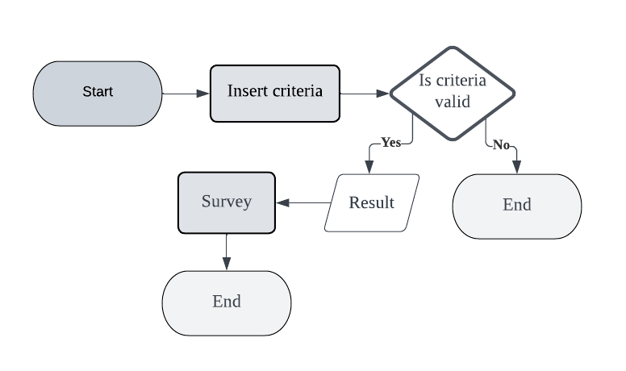
PROBLEM SOLVING APPROACH

Slide 6

COMPETITOR ANALYSIS
Features | Pitchbook | Crunchbase | StartupSavvy
Purpose | Financial data and software company that provides analysis and research on the private equity and venture capital markets. (Company-based) | Track startups and venture capital investments (Company-based) | Providing a platform specifically for individual at beginner level to make profit by investment. (Individual and company based)
Data coverage | Covers a wider range of companies, including early-stage startups. | Focuses on private equity and venture capital-backed companies. | Focuses on giving prediction and suggestion, real-time data and risk analysis.
User interface | More complex and may require more training or familiarity with financial data analysis tools. | More user-friendly and intuitive interface | More user-friendly and suitable for beginner in venture capitalist field.
Additional Features | Advanced features, such as portfolio tracking, customizable dashboards, and API access | Offers a news and trends section; community forum and collaboration | Providing a real-time stock value and risk management as a reference for evaluation.

Slide 7

FUTURE RECOMMENDATION
Providing more startup list company with strong branding.
Strong Branding
Widen the display content such history of the success investors.
Portfolio Showcase
News section that highlights industry trends, market insights, and company updates.
News and Insights
Make it accessible using smartphone.
Mobile Optimization

Slide 8
THANK YOU
Feel free to listen your comments : )
~Byte Council | UMhack 2023

